Slide 1

We Are For You
A NGO Organisation
Batch 6
Team members
1.K Kartthik
2.D Krishna Karthik
3.B Subba Rayudu
4.Yakub Nayak

Slide 2
01
02
03
Problem Statement
Objectives
Tech stack,Uml Use Case Diagram
04
05
07
Uml Class Diagram
E-R Diagram
Junit and Codecoverage
Table of Contents

Slide 3
Problem Statement
In today’s world , millions of people struggle with issues such as poverty , social inequality , lack of education. Ngo’s play a vital role in addressing these issues.
Despite the efforts of Ngo’s , many people remain unaware of the various programs and initiatives offered by these organisations .
Ngo’s may struggle to attract funding and support from donors and partners without comprehensive and informative website that showcase their work and impact.

Slide 4
PROBLEM SOLUTION
*
Our NGO Organisation Website aims to address these challenges by providing :-
A user-friendly , informative and engaging platform for individuals to learn about its programs , achievements, and impact .
Our website will serve as a hub for the organisation initiatives , events ,and partnerships , and provide clear and concise information.

Slide 5
Objectives
To create a Ngo application that user can donate the money to a particular projects organised by Ngo and have accountability to the user.
Volunteers can participate in the projects organised by Ngo.
Benificiaries can register for the help and they can get help from the Ngo after verification of information provided by beneficiary.

Slide 6
WHAT WE ARE WORKING ON
DONORS
VOLUNTEERS
BENIFICIARIES

Slide 7
TECHNOLOGY STACK
Frontend | Reactjs
Backend | Spring Boot
Database | MySQL
ORM Mapping | JPA(Hibernate)
Testing | Junit, Mockito
Code Coverage | Eclemma, Jococo

Slide 8
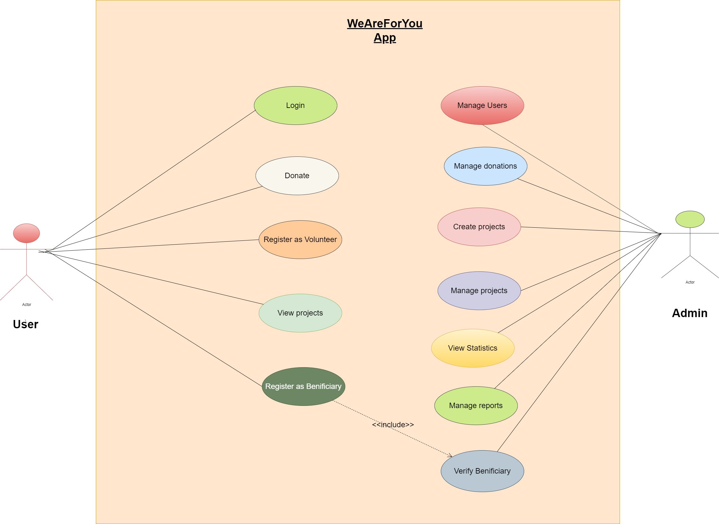
UML Use Case Diagram

Slide 9
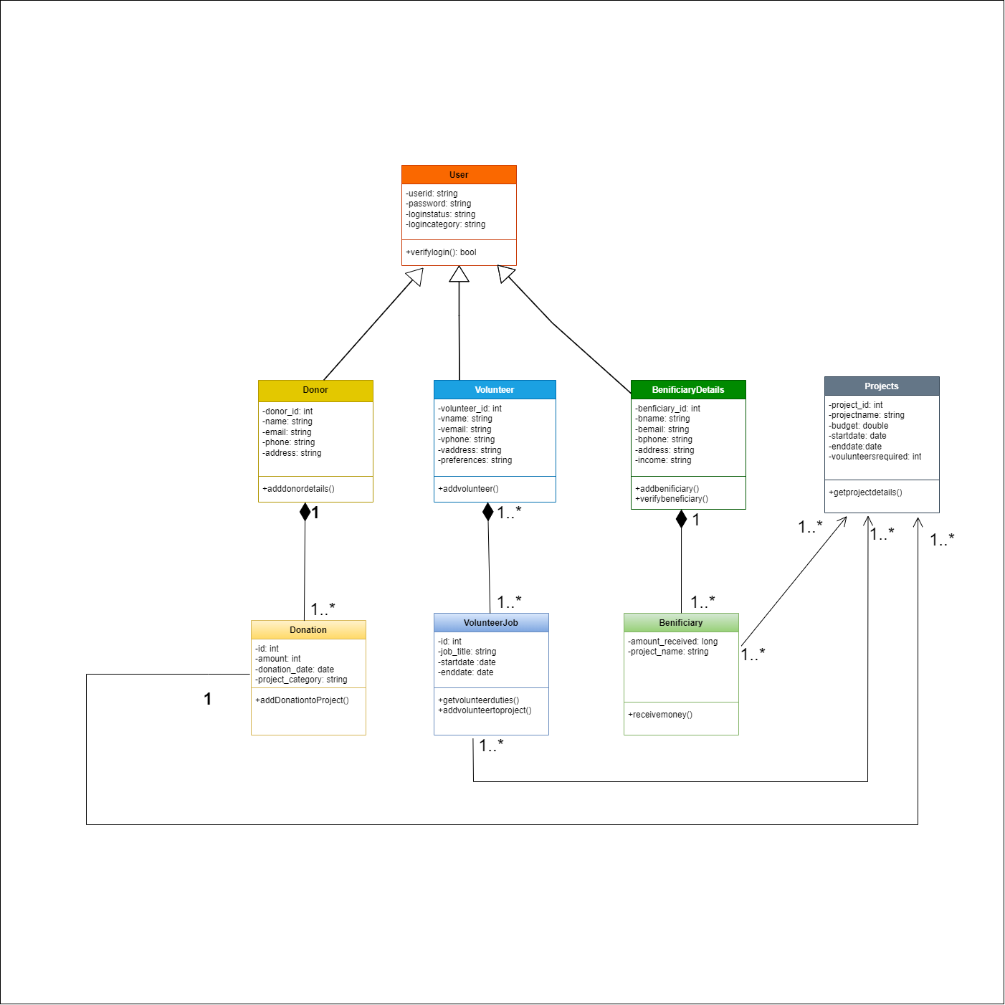
Class Diagram

Slide 10
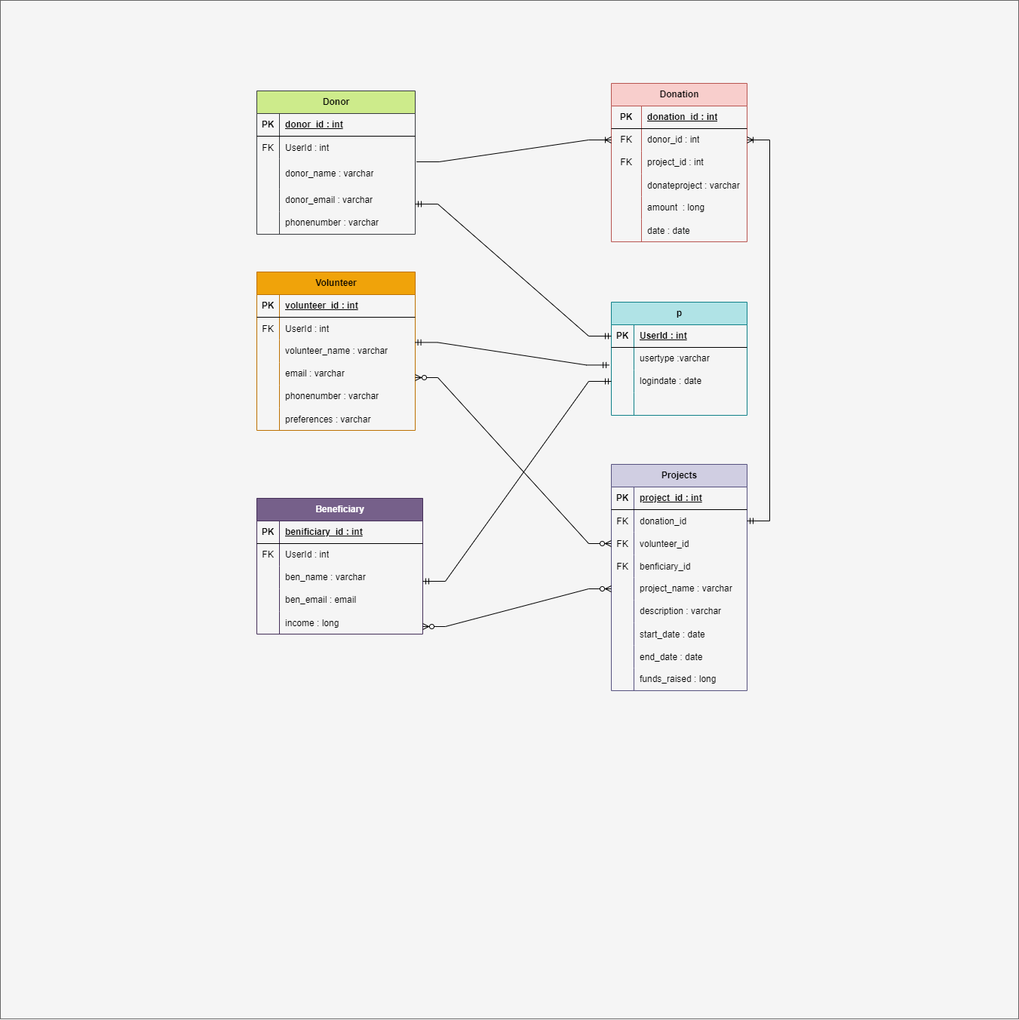
ER Diagram

Slide 11
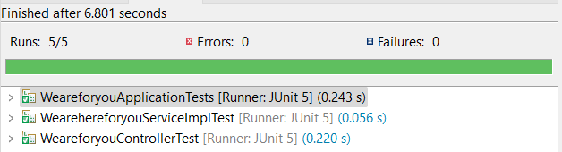
Test Case Generation using Juit and Mockito

Slide 12
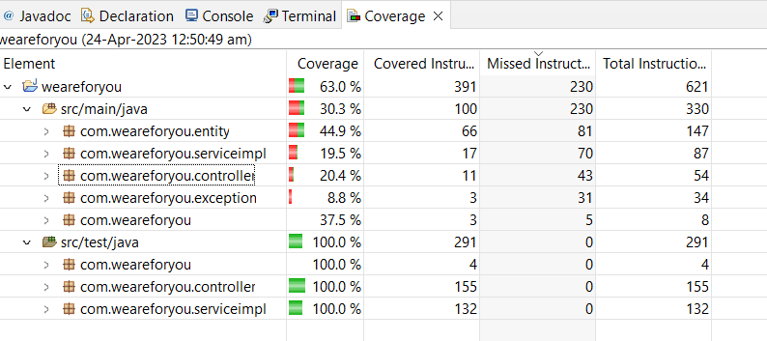
Code coverage analysis using Eclemma

Slide 13

SNEAK PEEK INTO OUR WEBSITE

Slide 14
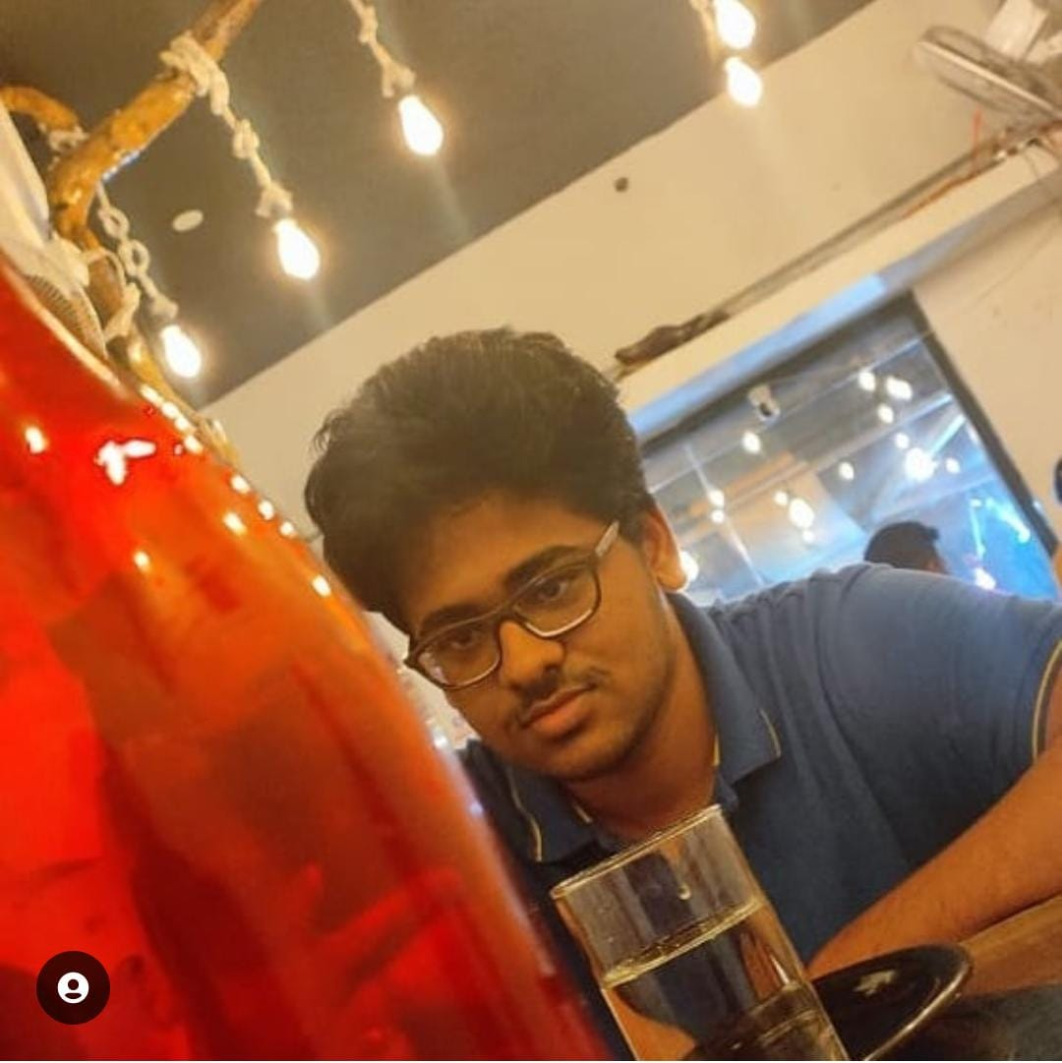


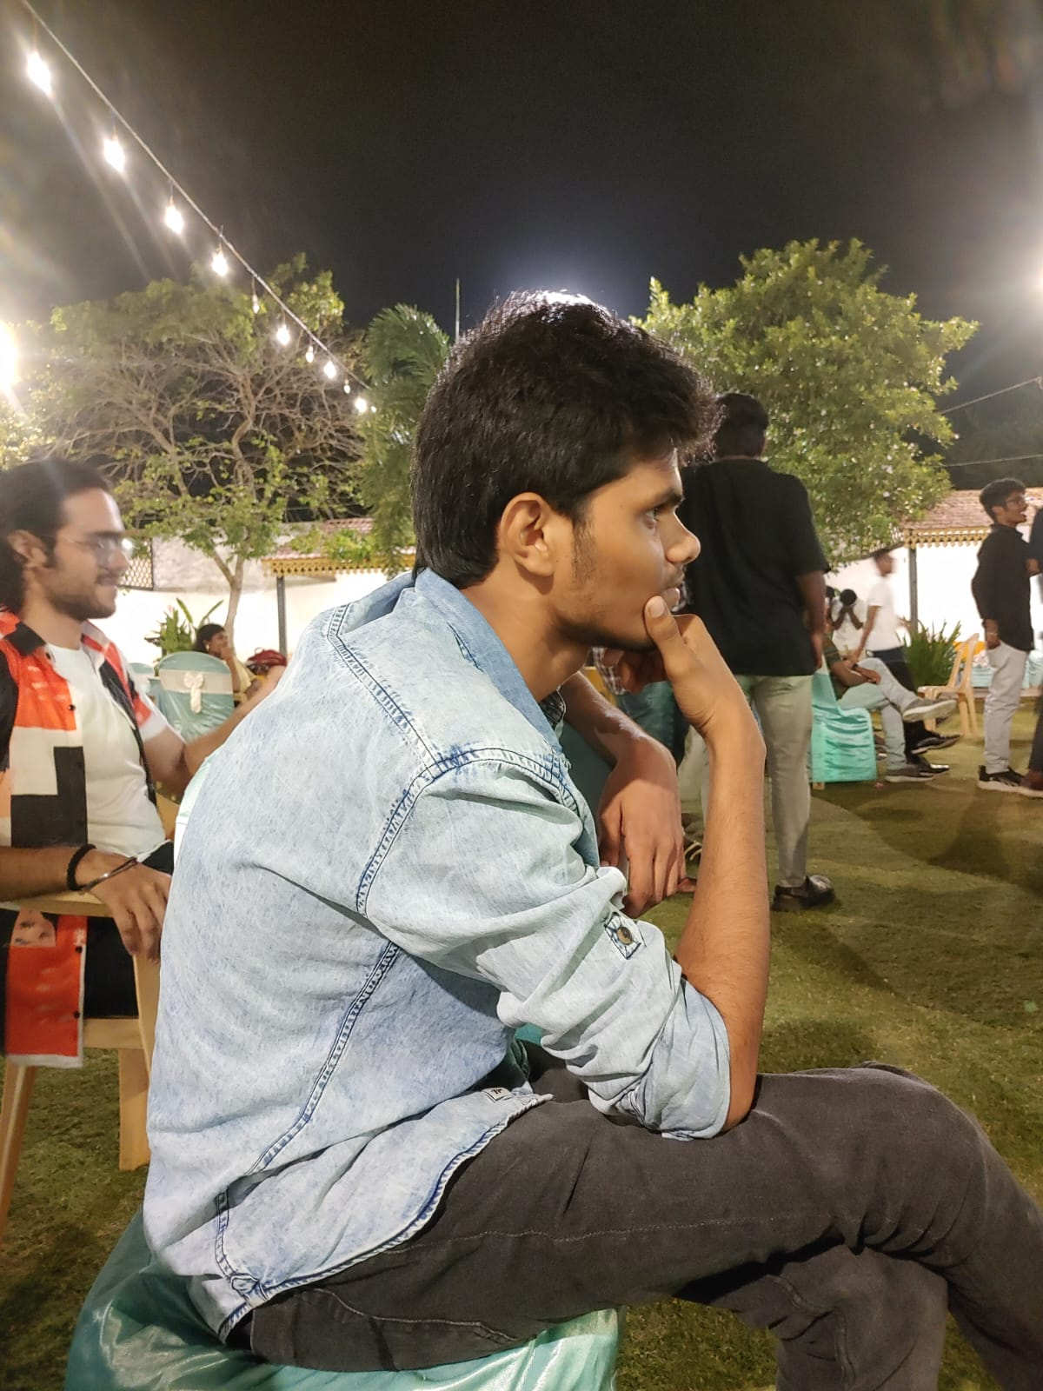
Our Team
B Subba Rayudu
K Kartthik
D Krishna Karthik
B Yakub
20CS1022
20CS1054
20CS1028
20CS1019

Slide 15
Thank You..

